Slide 1

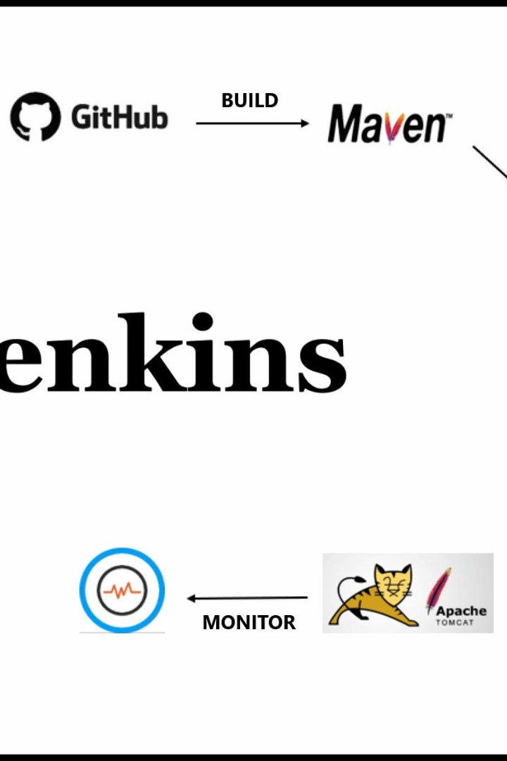

Unlocking the Power of Jenkins
Jenkins is an open-source automation server that helps streamline software development processes. Let's explore the many features and advantages Jenkins has to offer.
by Charanjit Singh

Slide 2
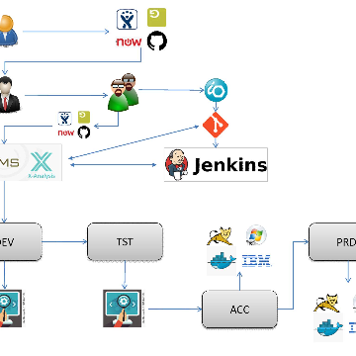
Introduction to Jenkins
Dashboard and UI
Pipelines
Scalability
Jenkins provides an intuitive UI, making it easy to navigate jobs, builds, and plugins.
Build detailed pipelines with Jenkins, managing complex builds, tests and deployments.
Jenkins can handle hundreds of jobs and nodes, allowing developers to work seamlessly.

Slide 3
Installation and Setup Process
Installation
Setup
Plugins
Install Jenkins on your machine by selecting your environment on the Jenkins homepage. It's that easy.
Easily configure Jenkins with the parameters of your choice. No need to worry about forgetting anything with Jenkins' guided setup.
With the hundreds of plugins available on the Jenkins platform, you can customize your installation exactly to your needs.

Slide 4
Jenkins Workflow Overview
Jenkins Job
Jenkins job is triggered to build, test and deploy the source code.
1
2
3
Source Code
Testing and Deployment
Developers commit code to a source code repository.
Tests are run, and artifacts are deployed through an automated process, saving time and increasing reliability.

Slide 5
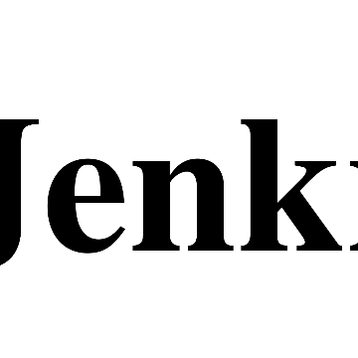
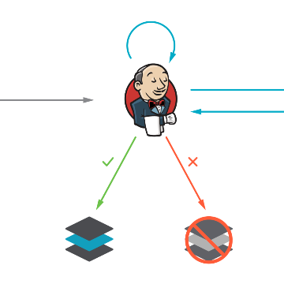
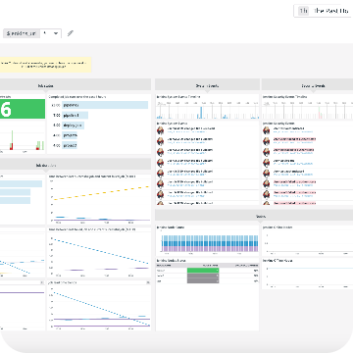
Jenkins Plugins and Integrations
Git
AWS
Slack
Integrate with Git to build and test automatically after every commit.
Connect Jenkins with Amazon Web Services to deploy applications reliably and at scale.
Get real-time feedback using Slack integration, making it easy to collaborate and stay informed.

Slide 6

Jenkins Best Practices
1
Keep Jenkins updated
2
Regular Maintenance
3
Use Source Control
Always install the latest updates to stay current with new features, fixes, and security patches.
Perform regular maintenance, such as cleaning up old and unused jobs, to keep Jenkins running smoothly.
Keep all job configuration files in source control, making it easy to understand how jobs are created and configure.

Slide 7
Conclusion and Q&A Session
Jenkins Key Benefits
Get Started Today
Easy Installation and Setup
Download Jenkins
Integration with Leading Technologies
Install Your Desired Plugins
Customizable and Scalable
Create Your First Job

Slide 8

Thank You
Thank you for learning more about Jenkins. Are you ready to make the jump and incorporate it into your software development workflow?

